Slide 1
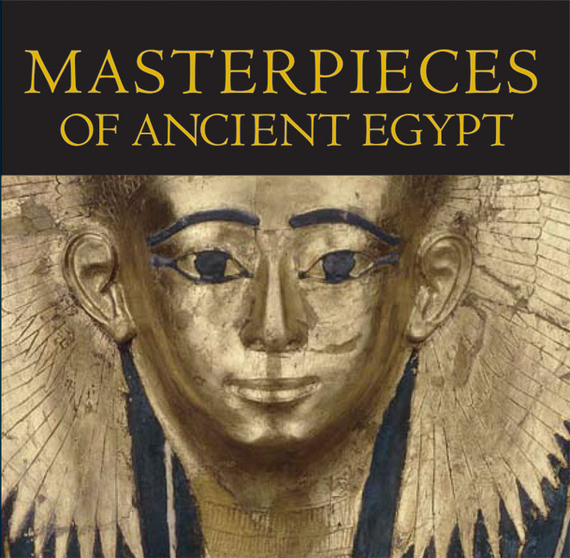
How Ancient Egyptians Influenced Modern Life

Slide 2
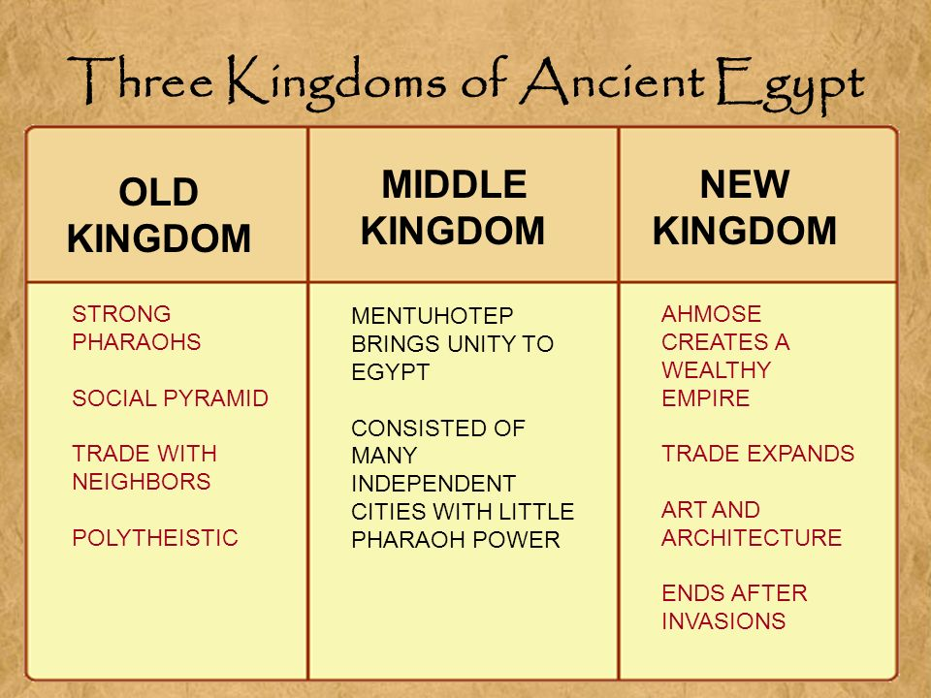
Introduction
The history of ancient Egypt occurred as a sequence of stable kingdoms, which were separated by intermediate periods that were characterized by relative instability.
The kingdoms included; the old, the middle and the new kingdoms of the Early Bronze age, the middle bronze age and the late Bronze Age respectively.
The ancient Egyptians experienced considerable achievements that included quarrying, surveying, and techniques in construction, which supported the creation of monumental temples, pyramids among others. It left a legacy that continues to impact the modern life positively

Slide 3
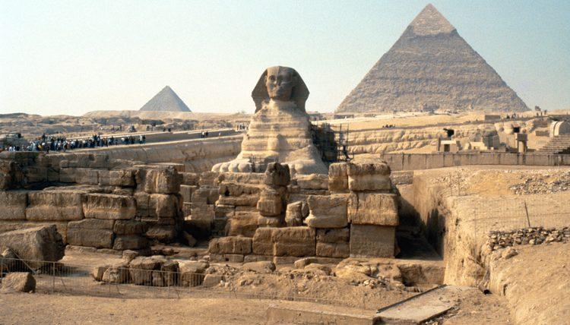
Egyptians were the first Builders
Imhotep, an Egyptian, built the Steppe Pyramid of Saqqara.
They also erected tombs and temples, which were floored and roofed with timber boards.
The concept of the master bedroom that is widely used today was first seen in ancient Egypt.
Among the tools and techniques that were pioneered by the Egyptian, builders include glass making using silica sand, lime and soda
They also built mortar and cement, customized bricks, ropes made of animal hair, among others. Their concept of art and designs is widely used around the world today.

Slide 4
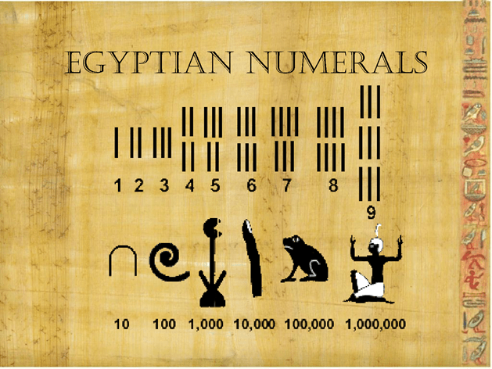
Egyptians and Mathematics
The first records of geometry were from them. Their specialists in geometry used ropes for purposes of subdividing and calculating the area of different lands.
The construction of pyramids also required advanced knowledge of mathematics, which, they had.
The invention of fractions by the Egyptians has also influenced modern life, and it is a method that is presently used extensively for calculation and divisions of land.

Slide 5
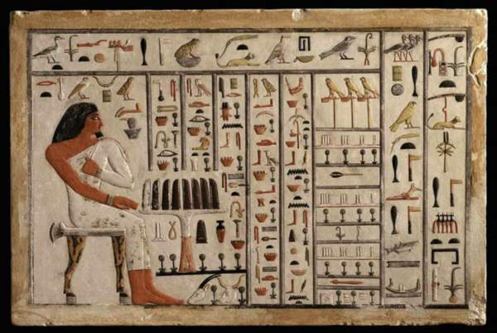
The Art of Writing
They discovered papyrus in 3000BC, which was a massive step up from carving words into stones, which they did early in their years.
Around 500BC, the papyrus spread and was used in West Asia and the Mediterranean for writing.
It became valuable and was one of Egypt's most profitable exports since it was expensive, and Egypt was its only maker at the time.

Slide 6
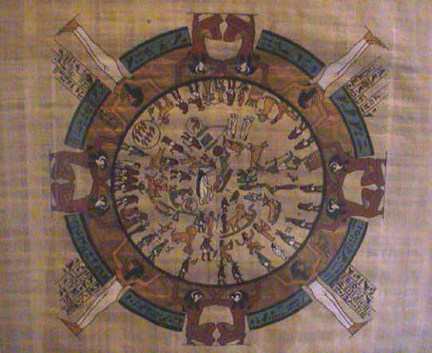
Measuring the World
The Egyptians invented a 354-day lunar calendar made up of 12 months, which correlated with the lunar cycle
Their calendar was split into three seasons, which reflected River Nile's natural cycle across the year
Before 30BC, there was an invention of a 365-day civil calendar that consisted of 12 lunar months of 30 days. That was still split into three seasons and five extra days at the end of the year.
During the 30BC, the Romans added an extra day to every fourth year to come up with the basis of the Julian Calendar, which was slightly revised to the current western calendar, which is known as the Gregorian Calendar.

Slide 7
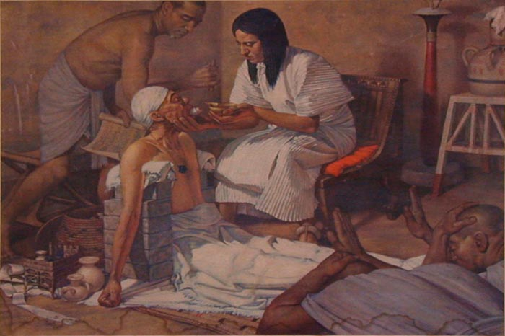
Egyptians and Medicine
Modern medicine owes much of their skills to the ancient Egyptians, who started treating their people using herbs.
Their medical problems came from their environment since they were living close to the Nile River, which despite the benefits brought about diseases and attacks from animals like hippos and crocodiles.
Due to the many health problems, the ancient Egyptians physicians came up and started treating the sick.

Slide 8
References
Bozeman, Adda B. Politics and culture in international history: from the ancient Near East to the opening of the modern age. Routledge, 2017.
Breasted, James Henry. A history of Egypt. Cambridge University Press, 2016.
Eller, Jack David. Cultural anthropology: global forces, local lives. Routledge, 2016.
Kluckhohn, Clyde. Mirror for man: The relation of anthropology to modern life. Routledge, 2017.
MacDonald, Sally, and Michael Rice, eds. Consuming Ancient Egypt. Routledge, 2016.
Moser, Stephanie. "Reconstructing Ancient Worlds: Reception Studies, Archaeological Representation and the Interpretation of Ancient Egypt." Journal of Archaeological Method and Theory 22, no. 4 (2015): 1263-1308.
Schweizer, Andreas. The sungod's journey through the netherworld: Reading the ancient Egyptian Amduat. Cornell University Press, 2017.

